Slide 1

Case study: Virtual assistant NLP integration

Slide 2

The problem
Virtual assistants can be too general:
Extract keywords from what is said and returns an info card with an answer
Misunderstand the point all together
Simply don't know the answer

Slide 3



Scenario: creating a shopping list
Suppose you want your device to help you make a grocery list
“Alexa, remind me to buy milk, rice, and blueberries”

Slide 4
The problem: MAKING An effective SHOPPING LIST
When you are done listing your groceries a virtual assistant can only ask basic questions:
“When do you want me to remind you?”
“Is that everything?”
It would be ideal if the virtual assistant would help us completing our shopping list in a smart and effective way

Slide 5
The solution:
NLP integration
An NLP can solve the problem by using real context clues from conversation, rather than just giving up when it can't find a predefined response for a set of keywords.

Slide 6



The idea
NLP
“Alexa, I am gluten free, help me complete my groceries shopping list.”
“Here are some items you may be missing: rice, corn, beans.”

Slide 7
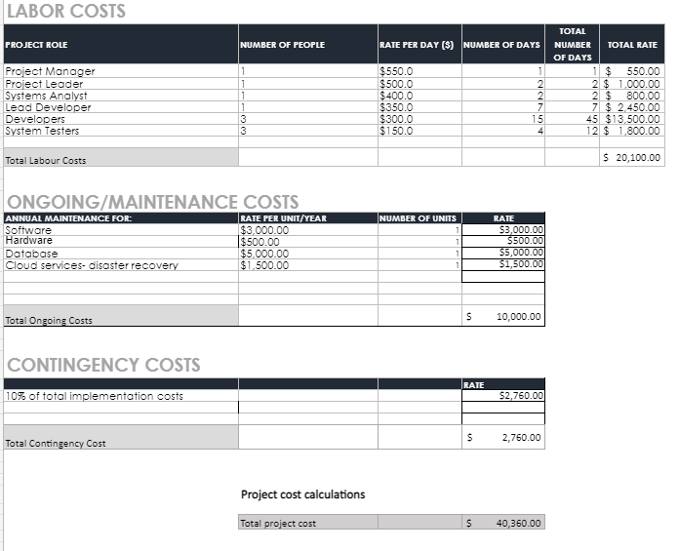
implementation costs

